Slide 1


ARA Consulting

Slide 2

Company Overview

Slide 3
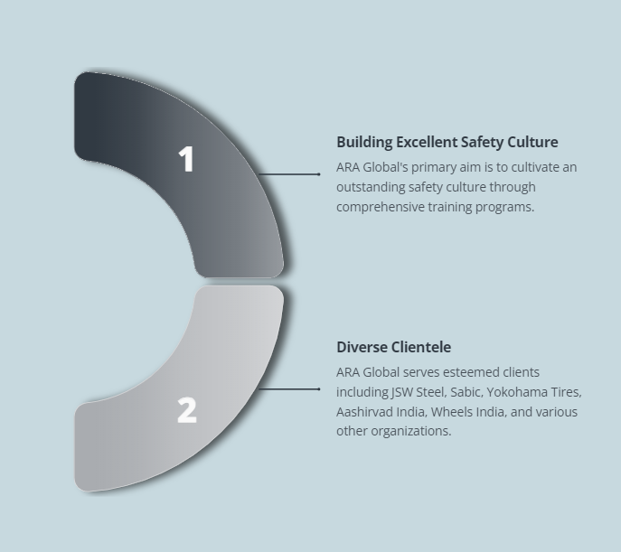
Leading provider of engaged training

Slide 4

Consultant profile
Total Corporate experience of 42 years of which 18 years as Senior VP/ VP capacity * Industry Exposure- Automobiles, Aeronautics, batteries, Spinning Mills, Textiles, Garments and Shoes and Metro Rail * Companies worked-India Pistons, AMCO, HAL, Madura Coats, Florsheim Shoes and Chennai Metro Rail * Functions handled- industrial engineering, Production, Operations, Logistics, Supply Chain , Quality and Project Management * Developed and delivered the entire Production and Operations Management Course for My B School for online teaching (30 hours) which is being used by ITM- Gaziabad and IIM Ranchi * Developed and delivered the entire online teaching in operations Management (30 hours) for working executives for Confederation of Indian industries * Facilitator of several Management Development Programmes such as Change Management, Decision making, Managerial Effectiveness, Resources Management and Leadership Development * Guest lectures in B -schools on many Management subjects * Developed and conducted specific in-house training programmes for companies for Management/ Supervisors development based on gap/ need analysis

Slide 5
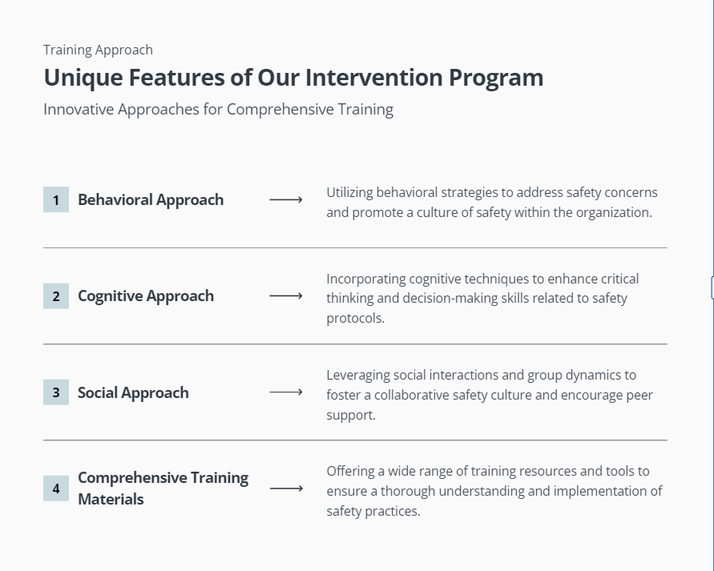

Slide 6

Personalized training program

Slide 7
Workstreams
W1: Diagnosis and Feedback
W2: Leadership Alignment
W3: Integrated Organization Structure
W4: Safety Observations
W5: Incident Investigation
W6: Standards & Procedures implementation

Slide 8
W1: DIAGNOSIS AND FEEDBACK
Key Interventions
• Understanding Your Culture (UYC) mirroring workshop
• Field Observations
• Data analysis
• One-on-One dialogues
• Focused group discussions
Observation of Safety Observers
• Feedback of Draft Diagnostic Study report in the Accept, Aspire and Act (AAA) workshop
Outcomes
• Finalized Diagnostic study report
• Finalized Intervention plan

Slide 9
W2: LEADERSHIP ALIGNMENT
Key Interventions
2 day “Safety Leadership and Culture” program for 25 Senior Managers
Outcomes
25 persons (Function Heads, HODs, Section Heads) trained in Leadership and its impact on culture.

Slide 10
W3: INTEGRATED ORGANIZATION STRUCTURE
Key Interventions
Coach / support / participate in Plant Steering Committee Meeting
Outcomes
Effective, disciplined and result oriented team meetings
Coach / support / participate in existing sub-committees to enhance leadership, teamwork and participation in the effective implementation of site action plan
Review and report differential performance of each committee
Enhanced leadership and teamwork
Stronger involvement and therefore stronger commitment of all the participants
Effective organization structure to ensure long-term trust

Slide 11
W4: SAFETY OBSERVATIONS
Key Interventions
Enhance Safety Observation process for conducting observations across all levels
Outcomes
Enhanced risk perception and therefore appropriate risk responses by all involved
Improved leading safety indicators for the plant
Dynamic, real time and “here and now” communications on hazards and mitigation response
Coach senior managers on safety observation in the field
Coach senior managers to coach their juniors on safety observations
Support establishing Safety Observation Quality Observation program to sustain the effectiveness of the process.
Support SO committee to prioritize and focus on right KPIs for driving the effectiveness in SO process
Propagation of “I Care” and “I am cared” sentiment amongst all employees

Slide 12
W5: INCIDENT INVESTIGATION
Key Interventions
Provide training to employees on Incident Investigation process using Why-Why analysis
Outcomes
Improved ability to investigate incidents and apply learning’s so as to prevent recurrence
Lead, Coach and critique Investigation of Incidents
Strengthen process for reporting and learning from Near Miss incidents
25 persons trained in incident investigation Preliminary understanding of process safety incidents at the shop-floor
Systemic causes identified and tracking of recommendation closure done regularly

Slide 13
W6: STANDARDS & PROCEDURES IMPLEMENTATION
Key Interventions
Conduct initial assessment of the high-risk standards, already rolled out, in a sample section of the unit
Outcomes
Effective and consistent implementation of standards and procedures
Support site champions in creating the updated standard implementation plan
Support in effective implementation of the standards using findings of the assessment as a baseline
Improved competency of shop-floor personnel to apply standards to mitigate risks.

Slide 14
Thank you
sales@araglobalinc.com
www.araglobalinc.com

